Slide 1
Data visualization for survey application tool
Uti Princess Oghenefejiro
22nd September 2024

Slide 2
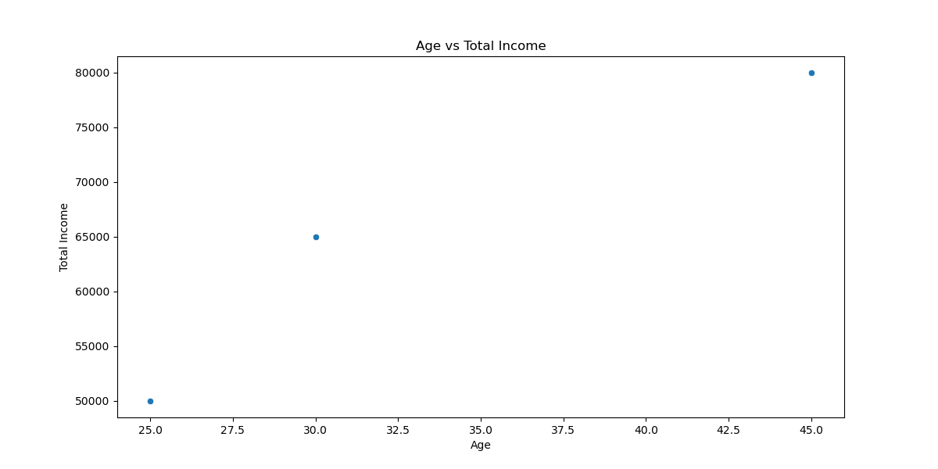
Overcoming nervousness

Slide 3
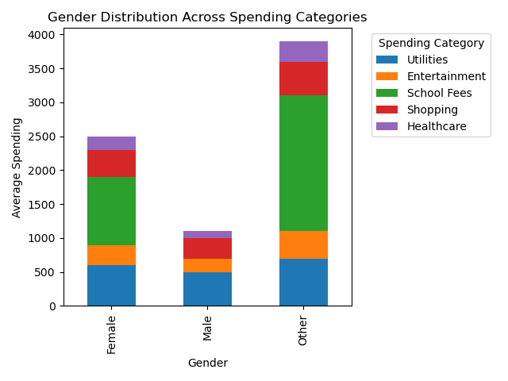

Slide 4
Reference
Python Data Visualization: A Comprehensive Guide | Datylon. (2024). Datylon.com. https://www.datylon.com/blog/a-complete-guide-to-python-data-visualization
Agrawal, R. (2021, October 27). What is Flask | A Comprehensive Guide on using Flask for Data Science. Analytics Vidhya. https://www.analyticsvidhya.com/blog/2021/10/a-comprehensive-guide-on-using-flask-for-data-science/

Slide 5
THANK YOU

